Slide 1

Funny Training Gorilla 澳洲土逗-IT培训
Your success is our success
Keyboard Actions

Slide 2
Learning Objectives
Checking for an element's presence
Checking for an element's state
Using Advanced User Interactions API for mouse and keyboard events
Performing double-click on an element
Performing drag-and-drop operations
Working with context menus
Executing the JavaScript code
Capturing screenshots with Selenium WebDriver
Maximizing the browser window
Handling session cookies
Working with browser navigation
Working with WebDriver events

Slide 3
Agenda
Big Picture
How Selenium Works Logically
POM
XPath
How Selenium Works Physically
Selenium Test
Demo – Mouse Action

Slide 4


Client – Server Delivery Model
HTML/CSS/JS
JSON/Http
API
SQL/JDBC
API
Web Tier
Database Tier
Business Tier

Slide 5



Big Picture
Content
HTML
Format
CSS
Web Page
Interact
with backend
JavaScript
Selenium emulates human
to interact with browser

Slide 6

How Selenium Works - Logically
HTML
CSS
JavaScript
HTML Source File
http://www.google.com
Selenium Java Code
?
Selenium WebDriver
Web App Server
Web Page
Selenium emulates human to interact with browser

Slide 7
Take “human” Action
Compound Locators
Relative Locators
Mouse Action
Keyboard Action
Location strategy
1
2
3
POM
Locate the right place
Take actions
tag
Xpath,
element,
attributes (Id, name, class
link text
CSS Selectors
etc
WebElement methods
User Gestures
Waiting strategy
Open/close window
Click
Summit
Select
navigate
etc.

Slide 8
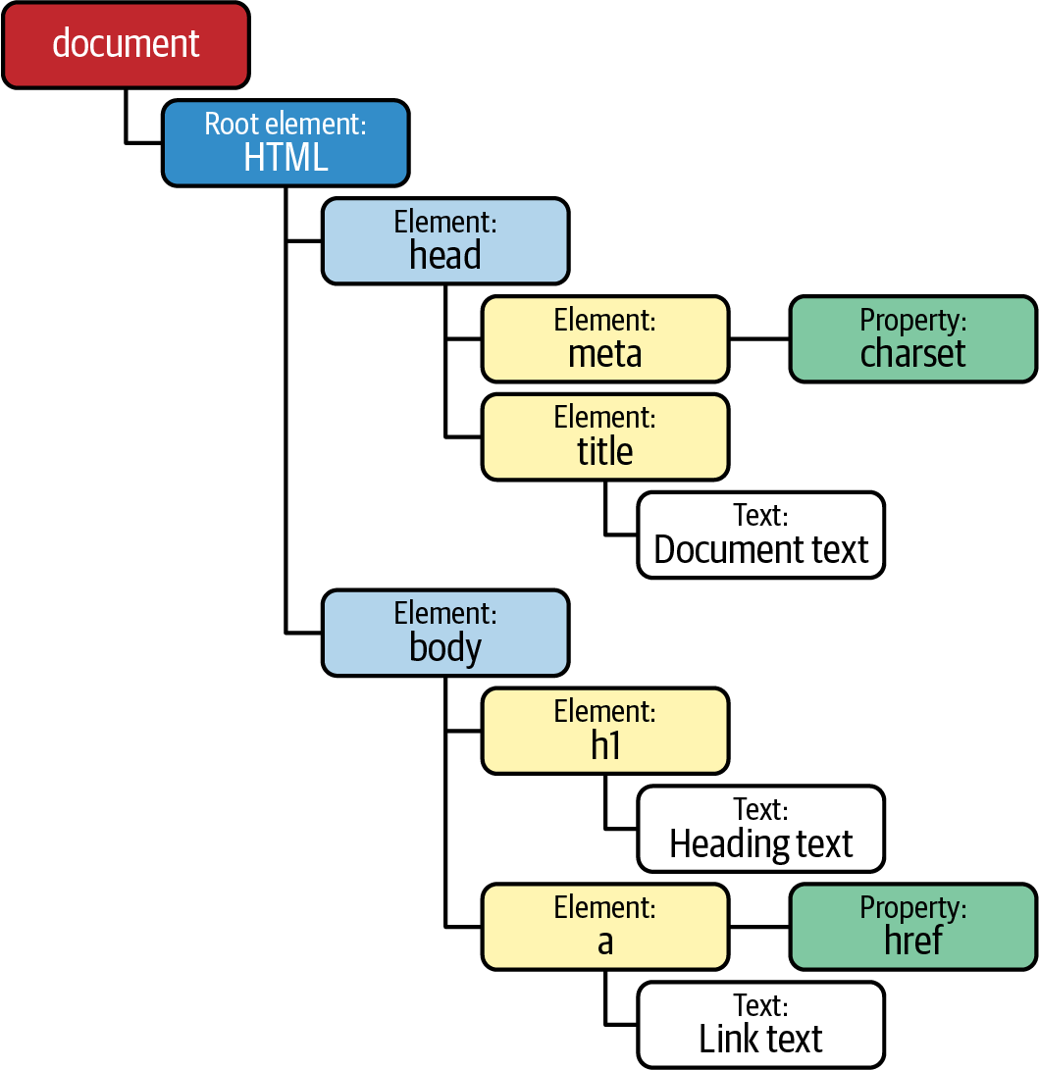
Understand Web Page Object Model (POM)
HTML + CSS + JavaScript
<HTML>
<HEAD>
<TITLE>Your Title Here</TITLE>
</HEAD>
<BODY BGCOLOR="FFFFFF">
<CENTER><IMG SRC="clouds.jpg" ALIGN="BOTTOM"> </CENTER>
<HR>
<a href="http://somegreatsite.com">Link Name</a>
is a link to another nifty site
<H1>This is a Header</H1>
<H2>This is a Medium Header</H2>
Send me mail at <a href="mailto:support@yourcompany.com">support@company.com</a>.
<P> This is a new paragraph!
<P> <B>This is a new paragraph!</B>
<BR> <B><I>This is a new sentence without a paragraph break, in bold italics.</I></B>
<HR>
</BODY>
</HTML>

Slide 9
Location Strategy
Method | Syntax | Description
By ID | driver.findElement(By.id (<element ID>)) | Locates an element using the ID attribute
By name | driver.findElement(By.name (<element name>)) | Locates an element using the Name attribute
By class name | driver.findElement(By.className (<element class>)) | Locates an element using the Class attribute
By tag name | driver.findElement(By.tagName (<htmltagname>)) | Locates an element using the HTML tag
By link text | driver.findElement(By.linkText (<linktext>)) | Locates a link using link text
By partial link text | driver.findElement(By.partialLinkText (<linktext>)) | Locates a link using the link's partial text
By CSS | driver.findElement(By.cssSelector (<css selector>)) | Locates an element using the CSS selector
By XPath | driver.findElement(By.xpath (<xpath>)) | Locates an element using XPath query
Chrome Developer Tool
https://yizeng.me/2014/03/23/evaluate-and-validate-xpath-css-selectors-in-chrome-developer-tools/

Slide 10
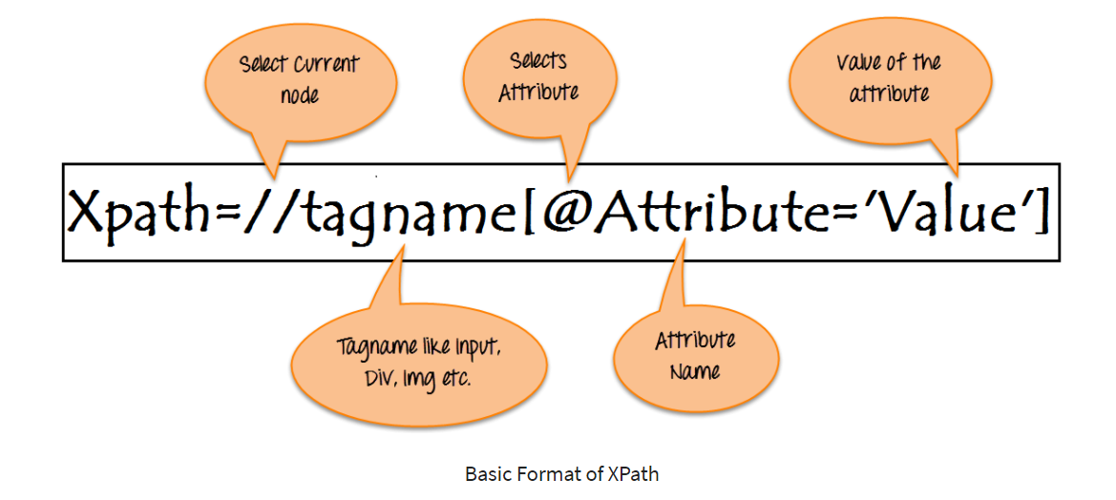
XPath

Slide 11
Common Selenium Action
Mouse Action
Keyboard Action
User Gestures
Waiting strategy

Slide 12
Common Selenium Action
driver.get("URL") | To navigate to an application.
element.sendKeys("inputtext") | Enter some text into an input box
element.clear() | Clear the contents from the input box.
select.deselectAll() | Deselect all OPTIONs from the first SELECT on the page.
select.selectByVisibleText("some text") | Select the OPTION with the input specified by the user.
driver.switchTo().window("windowName") | Move the focus from one window to another.
driver.switchTo().frame("frameName") | Swing from frame to frame.
https://www.tutorialspoint.com/selenium/selenium_webdriver.htm

Slide 13
Interaction
Text Box Interaction
Radio Button Selection
Check Box Selection
Drop Down Item Selection
Synchronization
Drag & Drop
Keyboard Actions
Mouse Actions
Multi Select
Find All Links

Slide 14
Java Implementation
1. Understand Web page source file: Page Object Model (POM)
2. Locate POM object: XPath, Id, name, etc.
https://www.guru99.com/xpath-selenium.html
3. Take action against selected element

Slide 15
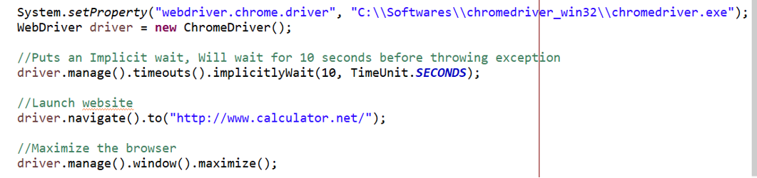
Selenium Java Part 1 - Setup

Slide 16
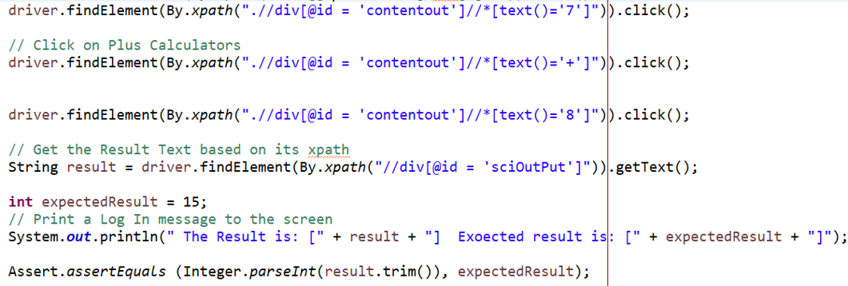
Part 2 – execute human actions

Slide 17
Part 3 – close window

Slide 18
Execute – Junit framework
Junit 4
Run as
Junit Test Cases
Junit 5
Junit 5 with Selenium-Jupiter
TestNG

Slide 19
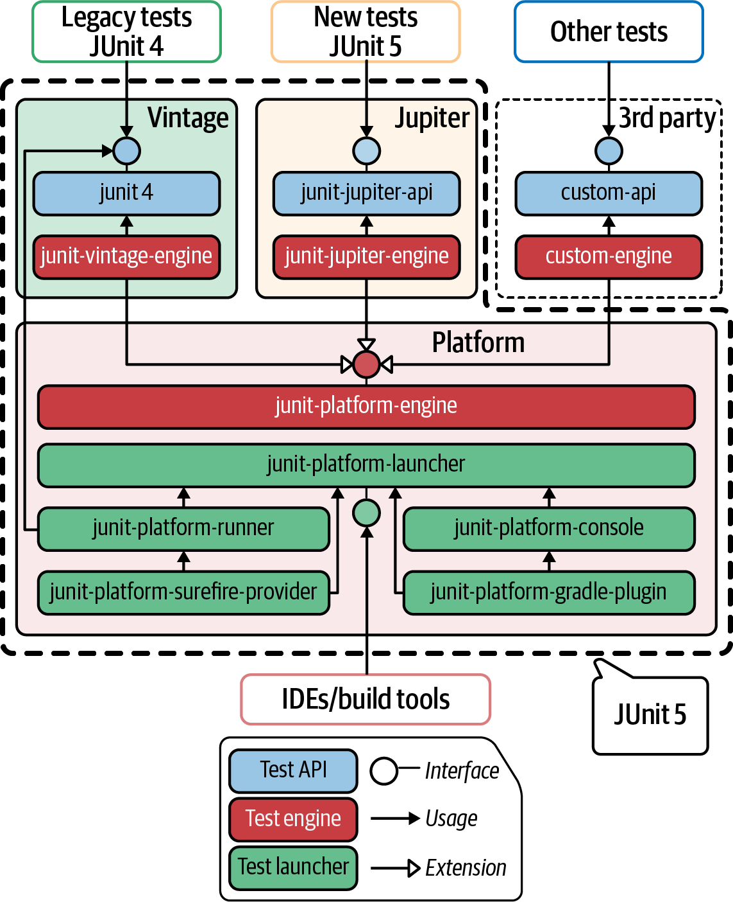
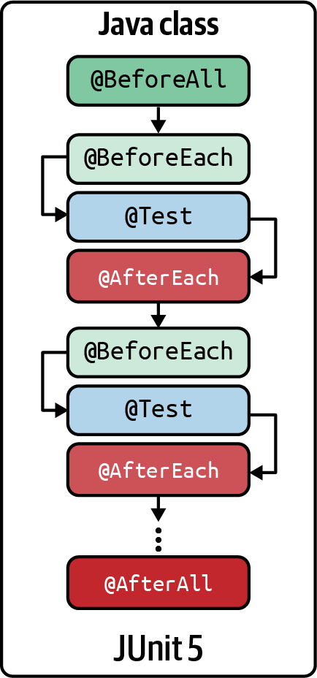
Junit 5

Slide 20
Selenium WebDriver Deployment
In real life:
A remote environment:
Different Browser types
Different Versions
Different OS types
Parallel testing
A fleet of different browsers
with different versions
deployed in different OS
1
Local browsers
Local browsers
2
Selenium Grid
Remote browsers
3
Cloud provider
4
Containerized Selenium Grid

Slide 21
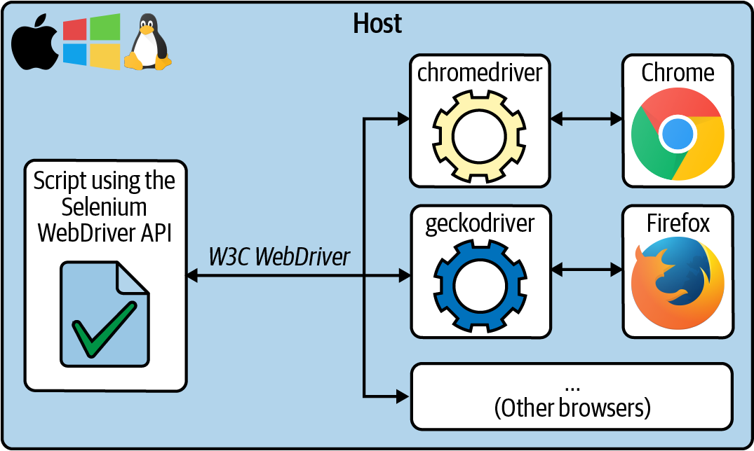
Using local browsers
Simple setup

Slide 22
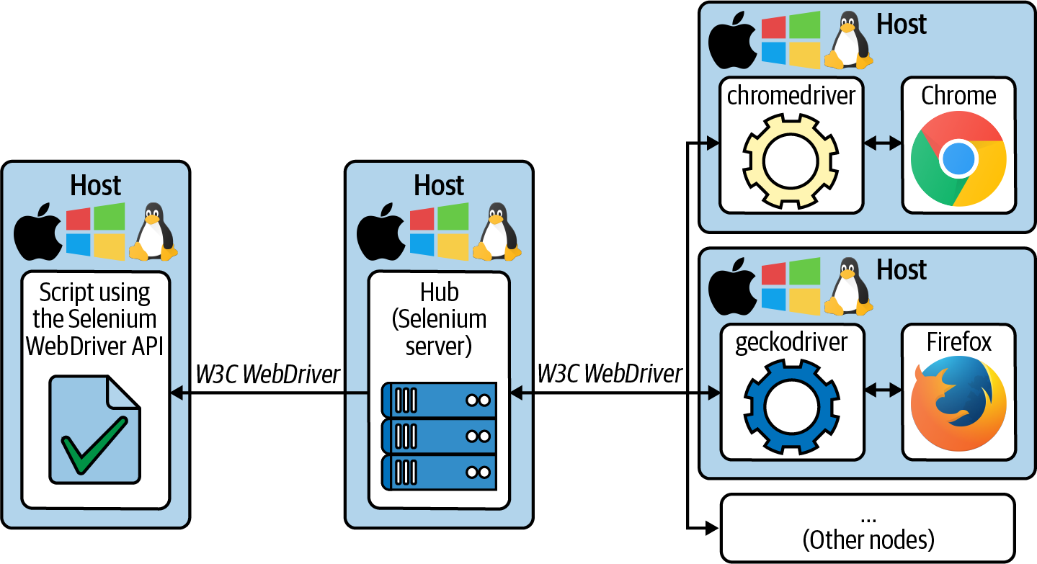
Using remote browser
Cross browser testing
Parallel testing

Slide 23






Selenium Grid – Remote Browser
https://www.calculator.net/
Test Code
Web Application
Selenium Grid
POM
JSON/Http
Chrome
WebDriver
Safari
WebDriver
Firefox
WebDriver

Slide 24
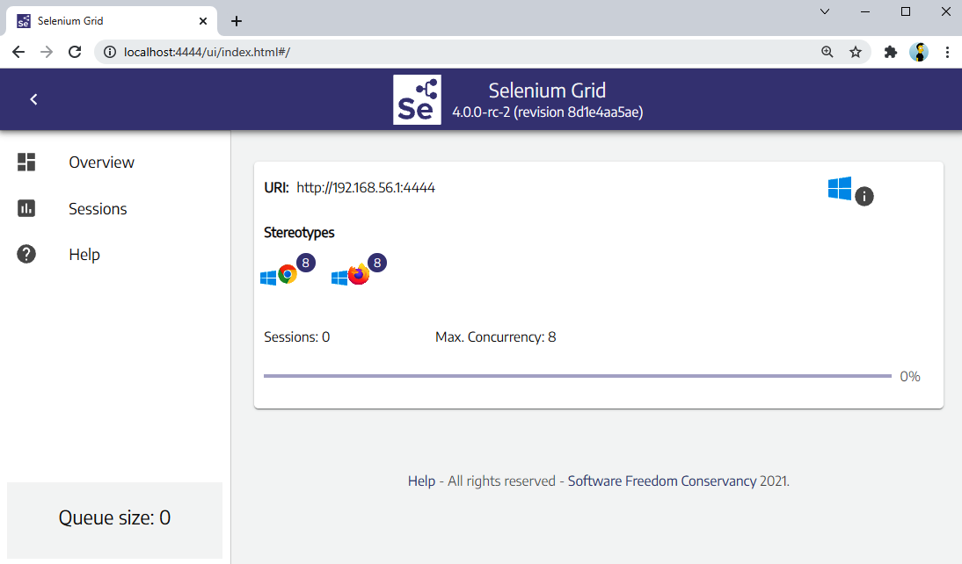
Selenium Grid
1
Standalone
2
Hub-nodes
3
Fully distributed

Slide 25
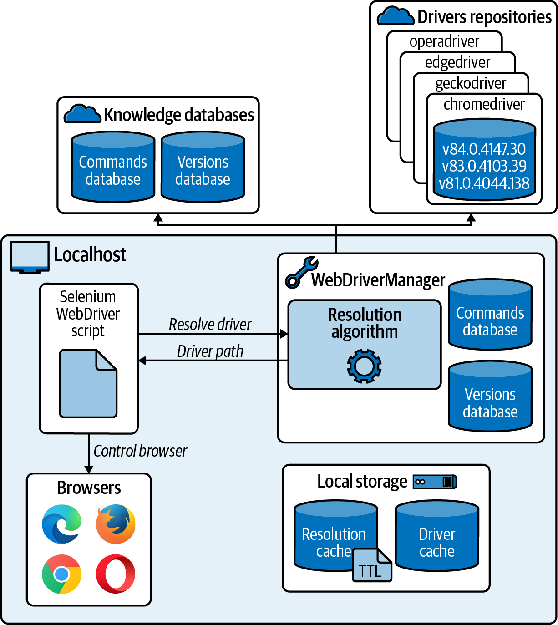
Standalone
java -jar webdrivermanager-5.0.3-fat.jar resolveDriverFor chrome
java -jar selenium-server-4.0.0.jar standalone
WebDriver driver = new RemoteWebDriver("http://localhost:4444/", new ChromeOptions());

Slide 26
Cloud Providers
Browsers as a service
Analysis capabilities
Mobile testing
Visual testing
Sauce Labs,
BrowserStack,
LambdaTest,
CrossBrowserTesting,
Moon Cloud,
TestingBot,
Perfecto, or
Testinium
Notes:
To request on-demand web browsers hosted by the providers. These browsers are usually of different types, versions, and operating systems. This feature is typically used for cross-browser automated or live testing.
To monitor and debug automated tests. To that aim, cloud providers typically support session recordings or rich error-reporting features.
To request emulated (and real) mobile devices on different platforms, such as Android and iOS.
Automatically inspect the UI and ensure that end users have a correct visual experience.

Slide 27
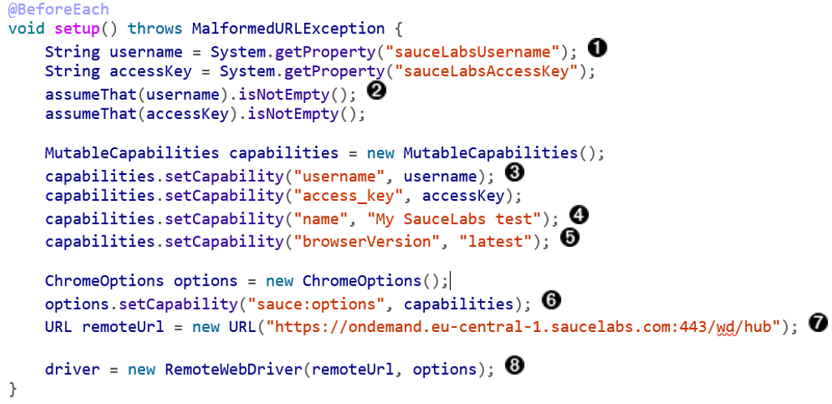
Cloud Providers

Slide 28
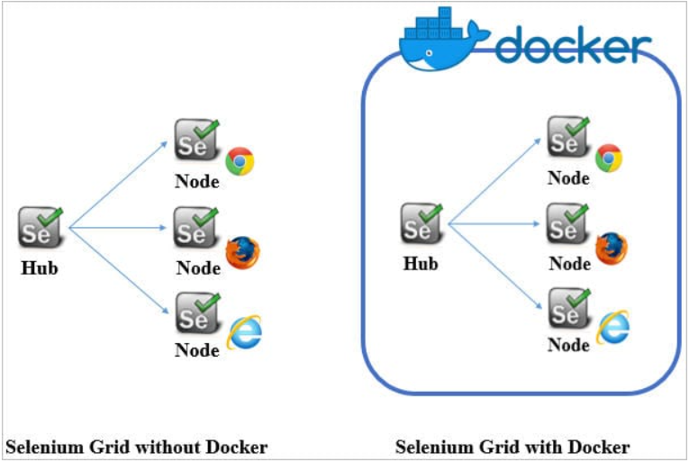
Containerized Selenium Grid

Slide 29
Put Everything Together

Slide 30
Selenium Environment Setup – Standalone Grid
Download Seleniue Grid
https://www.selenium.dev/downloads/
Download Chrome Driver
https://chromedriver.chromium.org/downloads
Download and configure Maven
https://maven.apache.org/download.cgi
Prepare eclipse
https://www.browserstack.com/guide/selenium-with-java-for-automated-test

Slide 31
References
Maven
Eclipse
https://www.vogella.com/tutorials/Eclipse/article.html
Java
XPath
https://www.guru99.com/xpath-selenium.html
Selenium tutorial
https://www.selenium.dev/documentation/webdriver/getting_started/
https://www.browserstack.com/guide/selenium-with-java-for-automated-test
https://www.tutorialspoint.com/selenium/selenium_webdriver.htm
https://www.lambdatest.com/blog/selenium-webdriver-tutorial-with-examples/
Code sample
https://www.lambdatest.com/blog/selenium-webdriver-tutorial-with-examples/

Slide 32
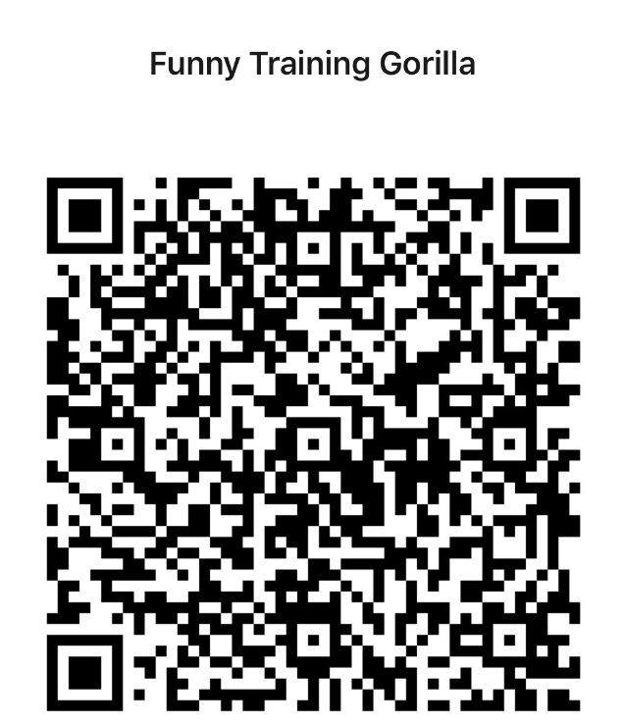
Contact
WebSite: www.funnygorilla.com.au
Mail: info@funnygorilla.com.au
Linkedin: https://mt.linkedin.com/in/songqing-gu-2ba9034b/de
WebChat: Funny Training Gorilla
Phone: 0420891343

